Slide 1
PYTHON FOR DATA · 40 MIN
Introduction to Machine Learning
Learning from data with scikit-learn · Unit 4
Data
Split
Model
Evaluate
Features and target
Train and test
Fit and predict
Score and validate
X y
train_test_split
fit predict
score metrics

Slide 2
The Machine Learning Workflow
~2 min
Learn from data, then test on new data.
1
Data
2
Split
Features X and a target y.
Keep a test set out of reach.
load_iris X y
train_test_split
3
Fit and score
4
Improve
Train, predict, then measure.
Cross-validate and use pipelines.
fit predict score
cross_val_score pipeline
Supervised learning has a target. Unsupervised learning does not.

Slide 3
Features and Target
~4 min
Rows are samples. Columns are features.
from sklearn.datasets import load_iris
iris = load_iris(as_frame=True)
X, y = iris.data, iris.target
print(X.shape, y.shape)
print(X.columns.tolist()[:2])
print(iris.target_names.tolist())
Features X
The input columns. Each row is one sample, here one flower.
Output
(150, 4) (150,)
['sepal length (cm)', 'sepal width (cm)']
['setosa', 'versicolor', 'virginica']
Target y
The answer to predict. A labelled target means supervised learning.

Slide 4
Train and Test Split
~4 min
Hold out data the model never sees.
from sklearn.model_selection import train_test_split
X_tr, X_te, y_tr, y_te = train_test_split(
X, y, test_size=0.2, random_state=0, stratify=y)
print(X_tr.shape, X_te.shape)
print(y_te.value_counts().tolist())
test_size
0.2 keeps 20% of the rows for testing. The model never trains on them.
Output
(120, 4) (30, 4)
[10, 10, 10]
random_state, stratify
A fixed seed repeats the split. stratify keeps class shares equal.

Slide 5
Fit and Predict
~4 min
Learn from the training rows only.
from sklearn.neighbors import KNeighborsClassifier
model = KNeighborsClassifier(n_neighbors=5)
model.fit(X_tr, y_tr)
pred = model.predict(X_te)
print(pred[:6].tolist())
print(y_te.tolist()[:6])
fit
Learns the pattern from X_tr and y_tr. Never call it on test data.
Output
[0, 1, 0, 2, 0, 1]
[0, 1, 0, 2, 0, 1]
predict
Returns a label for each row of new data. Compare it with y_te.

Slide 6
Evaluate the Model
~4 min
Score on data held out for testing.
from sklearn import metrics
print(round(metrics.accuracy_score(y_te, pred), 3))
print(round(model.score(X_te, y_te), 3))
print(metrics.confusion_matrix(y_te, pred))
accuracy
Share of correct predictions. 30 test rows is small, so stay cautious.
Output
1.0
1.0
[[10 0 0]
[ 0 10 0]
[ 0 0 10]]
Confusion matrix
Rows are true classes, columns are predictions. Off-diagonals are errors.

Slide 7
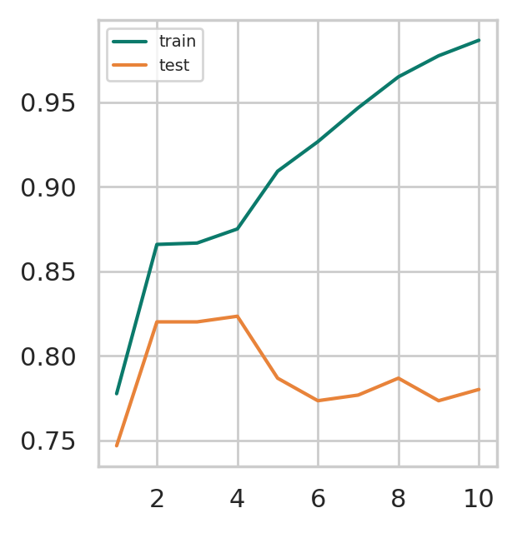
Overfitting
~4 min
A flexible model can memorize noise.
from sklearn import datasets, model_selection, tree
import matplotlib.pyplot as plt
X, y = datasets.make_moons(300, noise=0.4,
random_state=1)
clf, ds = tree.DecisionTreeClassifier(), range(1, 11)
tr, te = model_selection.validation_curve(clf, X, y,
param_name="max_depth", param_range=ds, cv=5)
plt.plot(ds, tr.mean(1), ds, te.mean(1))
plt.legend(["train", "test"])
Plot
Overfitting
The fix
Train score keeps rising while test score drops.
Limit depth or add data. Check with cross validation.

Slide 8
Cross-Validation
~4 min
Test on several splits, not one.
from sklearn.model_selection import cross_val_score
from sklearn.tree import DecisionTreeClassifier
scores = cross_val_score(
DecisionTreeClassifier(random_state=0),
X, y, cv=5)
print(scores.round(2).tolist())
print(round(scores.mean(), 3))
cv=5
Splits the data into 5 folds. Each fold is the test set once.
Output
[0.97, 0.97, 0.9, 0.97, 1.0]
0.96
Mean and spread
The average is steadier than one split. Check the spread too.

Slide 9
Regression Basics
~4 min
Predict a number instead of a class.
import numpy as np
from sklearn.linear_model import LinearRegression
rng = np.random.default_rng(0)
xs = rng.uniform(0, 10, (50, 1))
ys = 3 * xs[:, 0] + 2 + rng.normal(0, 1, 50)
reg = LinearRegression().fit(xs, ys)
print(reg.coef_.round(2), round(reg.intercept_, 2))
print(round(reg.score(xs, ys), 3))
coef_, intercept_
The learned slope and offset. Here close to 3 and 2.
Output
R squared
[3.05] 1.76
0.988
score gives R squared. Use test data for a fair value.

Slide 10
Pipelines and Scaling
~4 min
Chain steps so they learn from train only.
from sklearn.pipeline import make_pipeline
from sklearn.preprocessing import StandardScaler
from sklearn.linear_model import LogisticRegression
pipe = make_pipeline(StandardScaler(),
LogisticRegression(max_iter=200))
pipe.fit(X_tr, y_tr)
print(round(pipe.score(X_te, y_te), 3))
print(pipe.steps[0][0], pipe.steps[1][0])
Scale features
StandardScaler centres each column and sets its spread to 1.
Output
Why a pipeline
0.967
standardscaler logisticregression
The scaler is fitted on training rows only, so nothing leaks.

Slide 11
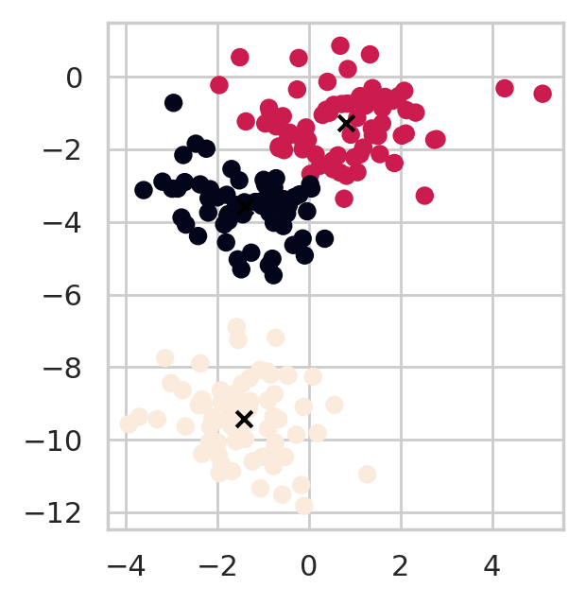
Unsupervised: KMeans
~4 min
Find groups without a target.
from sklearn.cluster import KMeans
from sklearn.datasets import make_blobs
X, _ = make_blobs(200, centers=3, random_state=2)
km = KMeans(n_clusters=3, n_init=10, random_state=0)
labels = km.fit_predict(X)
plt.scatter(X[:, 0], X[:, 1], c=labels)
plt.scatter(*km.cluster_centers_.T, c="k", marker="x")
Plot
No target y
Choose k
KMeans only sees X. It groups rows that sit close together.
You pick n_clusters. Try several values and compare.

Slide 12
Machine Learning Cheat Sheet
~2 min
Match the task to the tool.
Task | Tool
Features and target | X, y
Hold out test data | train_test_split
Train a model | model.fit(X_tr, y_tr)
Predict labels | model.predict(X_te)
Score a model | model.score, metrics.accuracy_score
Fair estimate | cross_val_score(model, X, y, cv=5)
Scale, then model | make_pipeline(StandardScaler(), model)
Find groups | KMeans(n_clusters=k).fit_predict(X)
Never fit on test data. Compare train and test scores to spot overfitting.

